Slide 1

Documents and Business Rules

Slide 2

Types of Documents
Maintenance Documents
“Global” Maintenance Documents
Transactional Documents (everything else)

Slide 3
Business Rules
Base interface: BusinessRule (does nothing)
Lots of placeholder interfaces - not really used as intended
DocumentRuleBase
MaintenanceDocumentRuleBase

Slide 4

Base Document Business Rules
Subclass DocumentRuleBase
override only the “processCustom…” methods
  boolean processCustomSaveDocumentBusinessRules(Document document)
  boolean processCustomRouteDocumentBusinessRules(Document document)
  boolean processCustomApproveDocumentBusinessRules(ApproveDocumentEvent approveEvent)
  boolean processCustomAddNoteBusinessRules(Document document, Note note)
  boolean processCustomSendAdHocRequests(Document document)
  boolean processCustomAddAdHocRoutePersonBusinessRules(Document document, AdHocRoutePerson person)
  boolean processCustomAddAdHocRouteWorkgroupBusinessRules(Document document, AdHocRouteWorkgroup workgroup)

Slide 5
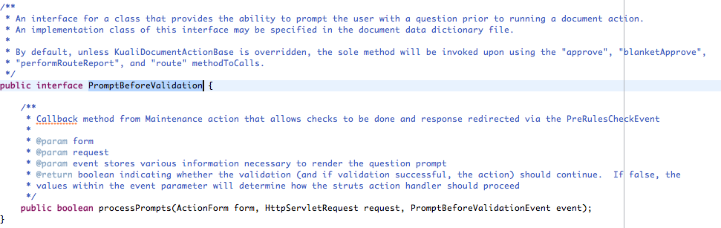
Pre-Rules?
PreRules have been refactored in the current Rice builds.
We Now Have:
  PromptBeforeValidation
  DerivedValuesSetter

Slide 6
Maintenance Documents
Used for editing simple BOs
Web interface generated automatically from metadata
No pending table required to store document data
Limited customizability

Slide 7
Maintenance Document Business Rules
Subclass MaintenanceDocumentRuleBase
All of the “processCustom” hooks exist as well as:
  boolean processCustomSaveDocumentBusinessRules(MaintenanceDocument document)
  boolean processCustomRouteDocumentBusinessRules(MaintenanceDocument document)
  boolean processCustomApproveDocumentBusinessRules(MaintenanceDocument document)
  boolean processCustomAddCollectionLineBusinessRules(MaintenanceDocument document, String collectionName, PersistableBusinessObject line)

Slide 8
Other Maintenance Document Functions
No separate document class/action for each document
Uses an interface called Maintainable which provides hooks
Extend KualiMaintainableImpl for your documents if needed
Maintainable class is specified in the DD

Slide 9
Maintainable Hooks
Many are based on standard actions that will happen to a document
  void processAfterRetrieve()
  void processAfterCopy( MaintenanceDocument document, Map<String,String[]> parameters )
  void processAfterEdit( MaintenanceDocument document, Map<String,String[]> parameters )
  void processAfterNew( MaintenanceDocument document, Map<String,String[]> parameters )
  void processAfterPost( MaintenanceDocument document, Map<String,String[]> parameters )
  void processAfterAddLine(String colName, Class colClass)
  void setupNewFromExisting( MaintenanceDocument document, Map<String,String[]> parameters )
  void handleRouteStatusChange(DocumentHeader documentHeader)
  void prepareForSave()
  void saveBusinessObject()
  void prepareBusinessObjectForAdditionFromMultipleValueLookup(String collectionName, BusinessObject bo)

Slide 10
Global Maintenance Documents
Acts like a transactional document
But has special hooks to properly handle BOs maintained through other maintenance documents
  Locks
  Deactivations

Slide 11
Transactional Documents
Build UI Yourself
Extend from the KualiDocumentActionBase and KualiDocumentFormBase classes
  Base classes will take care of standard actions (save/submit/etc…)
  Add methods with the following signature to add custom actions:
    public ActionForward edit(ActionMapping mapping, ActionForm form, HttpServletRequest request, HttpServletResponse response) throws Exception
Create a Document object to hold the data. Extend from TransactionalDocumentBase.

Slide 12
Transactional Documents (2)
Has many of the same hooks as the Maintainable
  void doRouteStatusChange(DocumentRouteStatusChangeDTO statusChangeEvent) throws Exception
  void handleRouteLevelChange(DocumentRouteLevelChangeDTO levelChangeEvent)
  void prepareForSave(KualiDocumentEvent event)
  void postProcessSave(KualiDocumentEvent event)

